Slide 1
Microeconomics for Business
Chapter 6 – Monopoly
Profit Maximization

Slide 2
Perfect Competition Assumptions | How firms try to beat it | Economic Term
All goods the same | Differentiate your product | Monopolistic Competition
 | Patent/Copyright | Monopoly
Many buyers and sellers | Horizontal/Vertical integration Price Wars | Monopoly Game Theory
Easy Entry/Exit | Erect barriers to entry | Regulatory Capture
Everyone knows price and good quality | Come up with ways to offer different prices to different consumers | Price Discrimination

Slide 3
BIG QUESTION:
What is a company you hate?

Slide 4
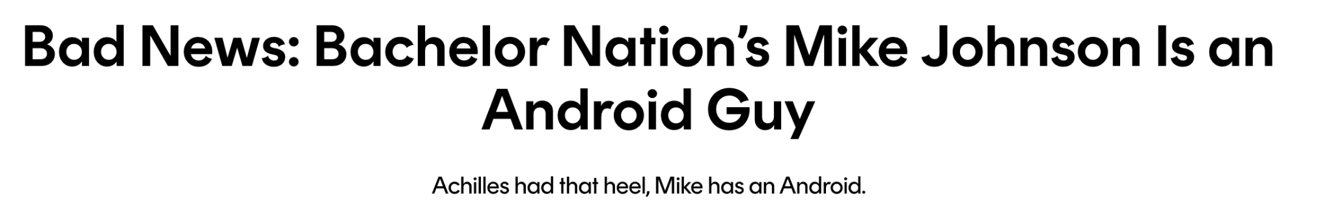
Bellringer

Slide 5
Which company do you love?

Slide 6

Bellringer

Slide 7
Pure Monopoly
In a perfectly competitive market, where many small firms produce the same good, individual firms do not impact market price.
Pure Monopoly is the market structure in which there is one firm producing a product for which there are no close substitutes.
Can you think of an example?

Slide 8
Examples: Local public utilities, a computer operating system, goods which have patents, government agencies, and people with special talents in labor markets

Slide 9
The market spectrum
Many firms
One firm
Present competition
Easy entry
Many barriers to entry
future competition

Slide 10
Profit Maximization
Perfect Competition:
Marginal Profit = 0
Marginal Revenue = Marginal Cost
Takes price as given
Monopolist:
Marginal Profit = 0
Marginal Revenue = Marginal Cost
PRICING POWER!!

Slide 11
Profit Maximization
Because the monopolist is the only firm in the market, it faces the entire market demand for its product.
Therefore, when the monopolist chooses quantity, it also chooses price.

Slide 12
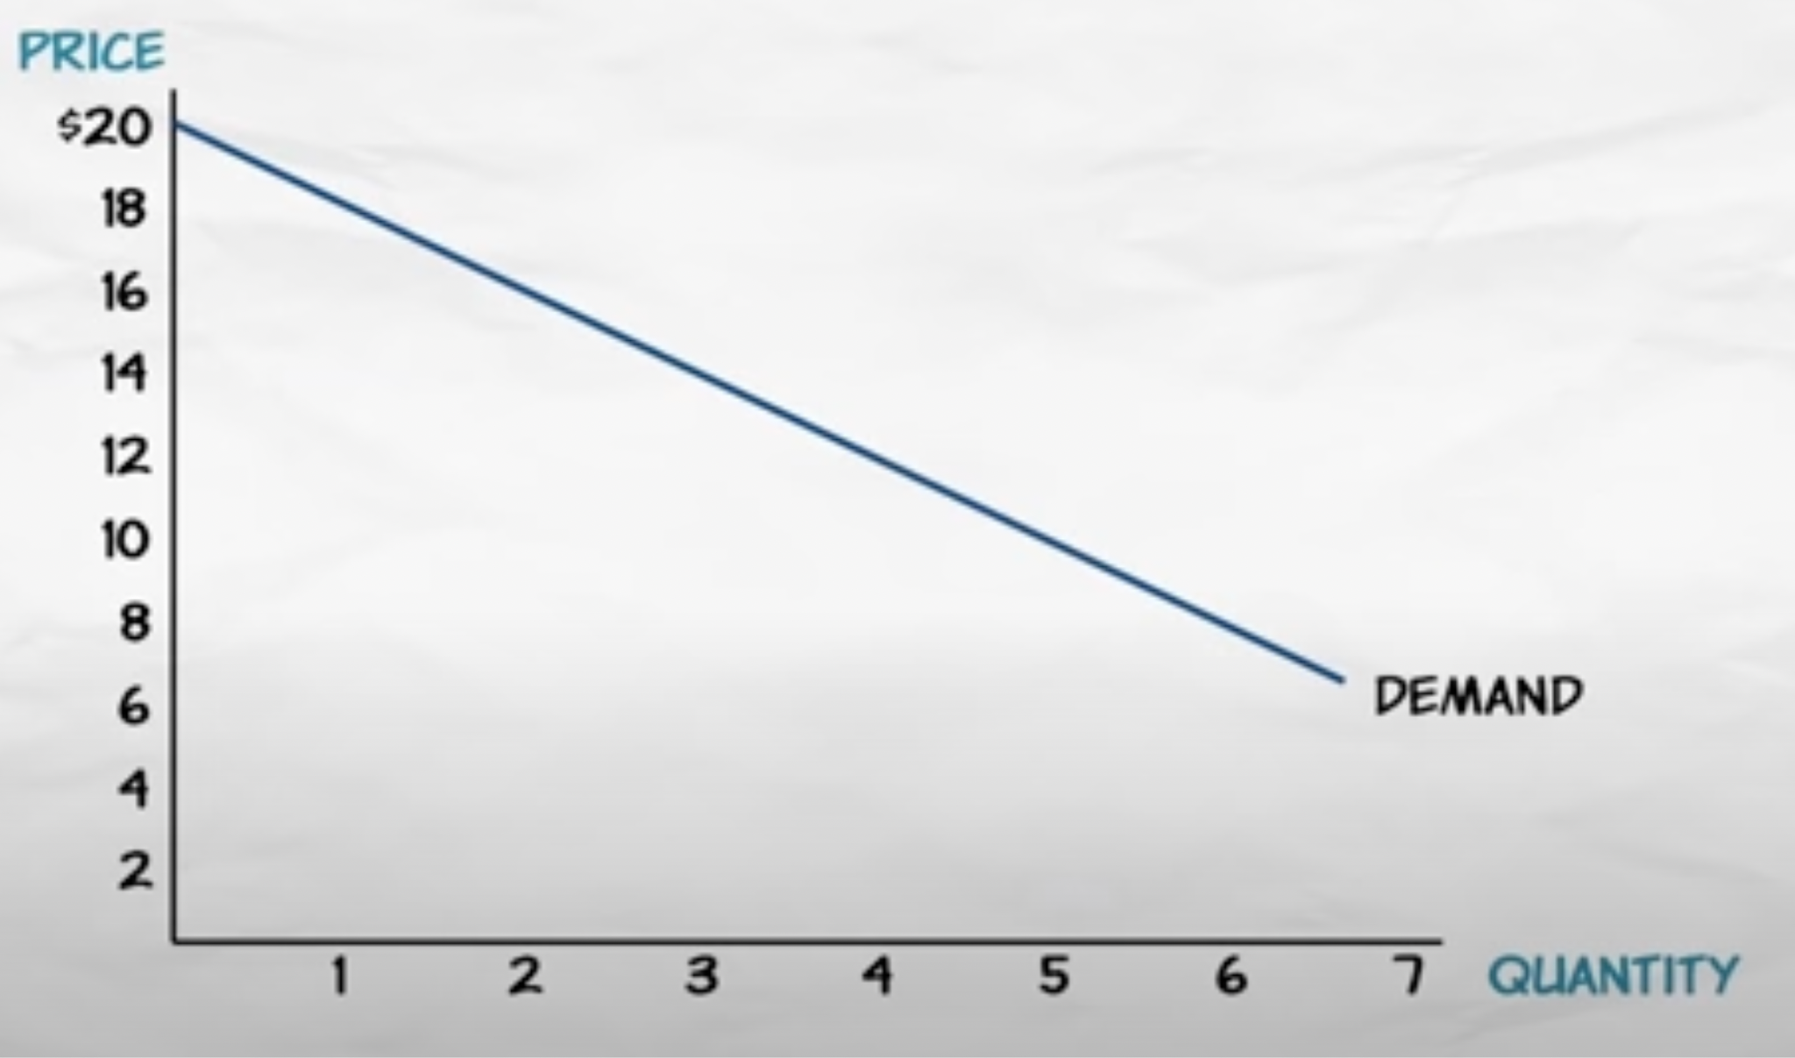
Monopoly
Price makers

Slide 13
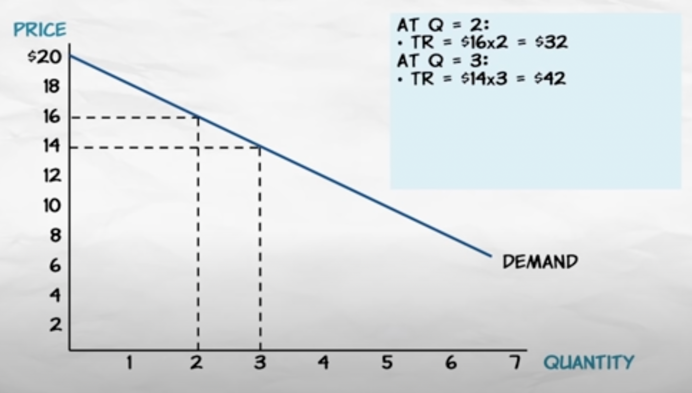
Marginal Revenue

Slide 14
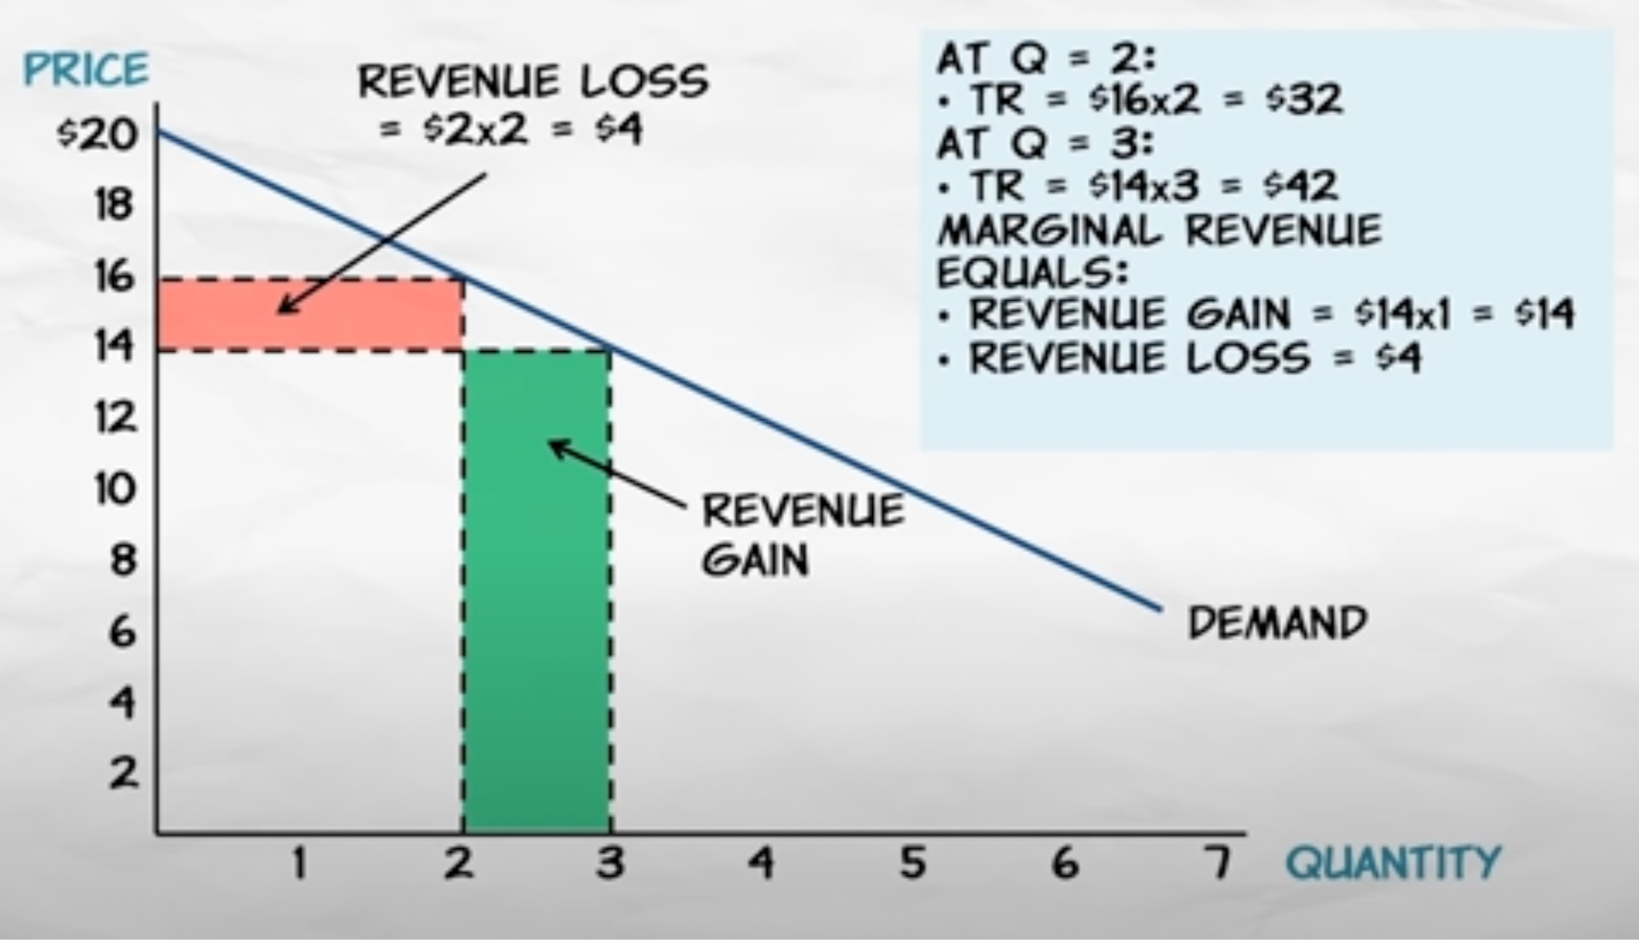

Slide 15
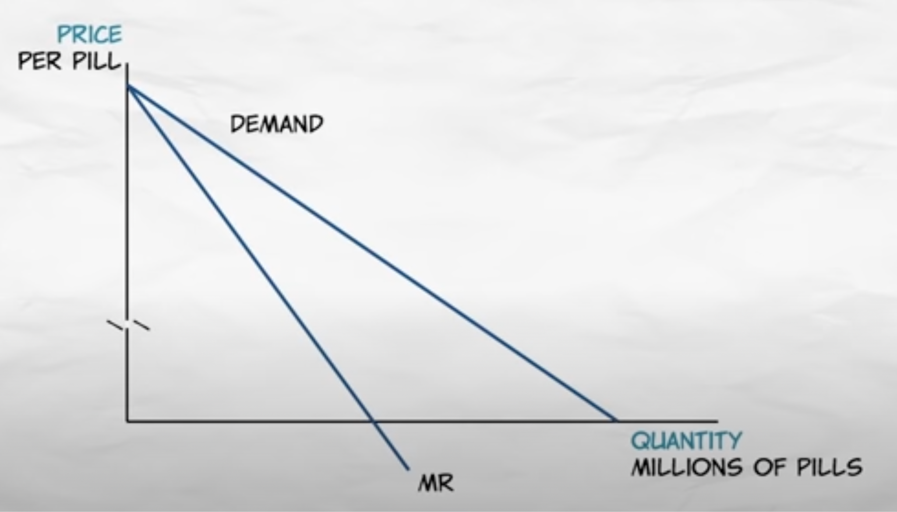

Slide 16
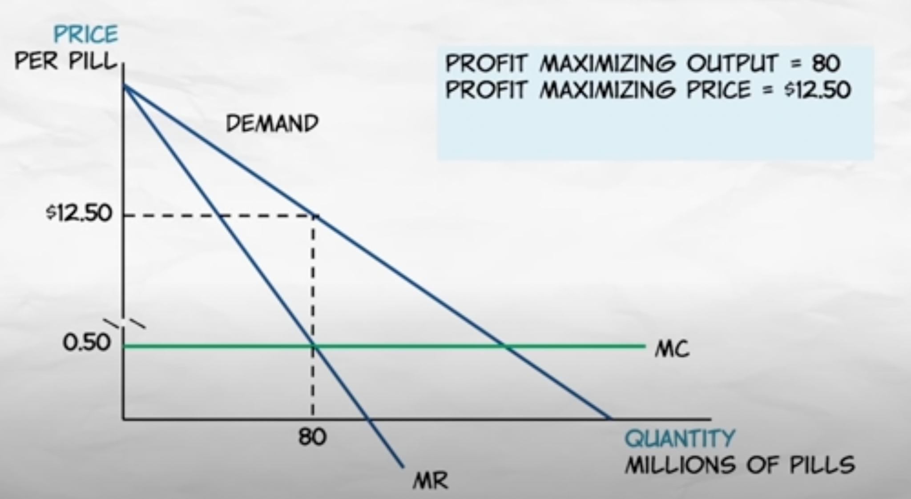

Slide 17
Profit-Maximizing Rule for Monopoly
Profit-maximizing rule for any firm:
MR = MC
Under perfect competition: P = MR
With a monopoly: P > MR
Notes:
Lecture notes:
Under perfect competition, the firm’s marginal revenue was simply the market price.
Since a monopolist is the only firm in the market, its marginal revenue will depend on what price it decides to charge.

Slide 18



Profit Maximization
Example:
Demand
Inverse Demand

Slide 19


Profit Maximization
Example:
Demand
Inverse Demand

Slide 20
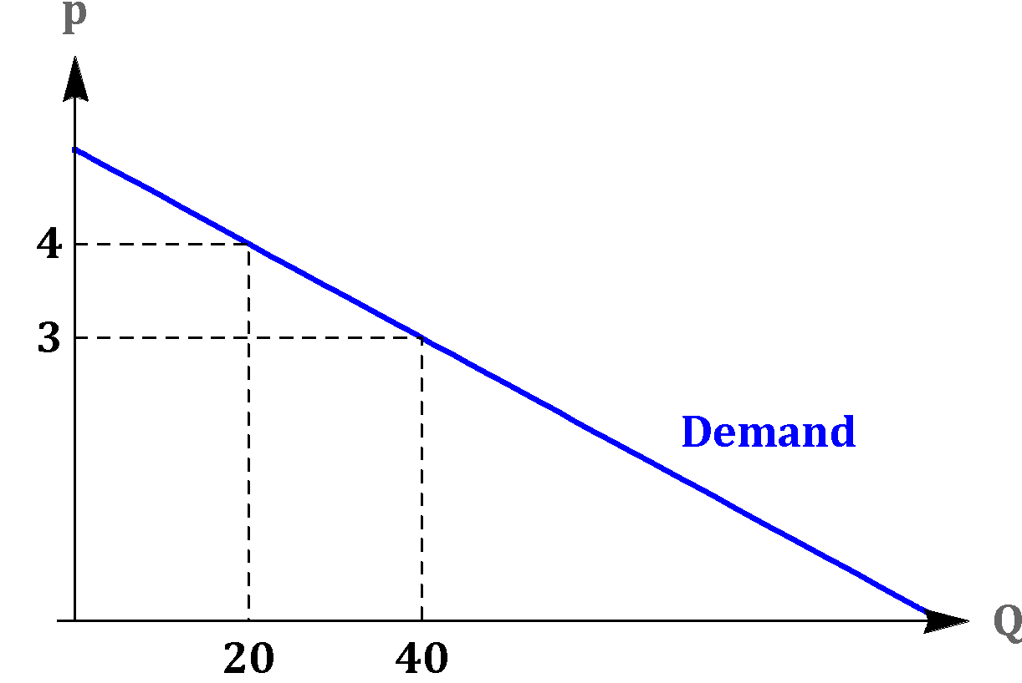

Profit Maximization
Example:

Slide 21
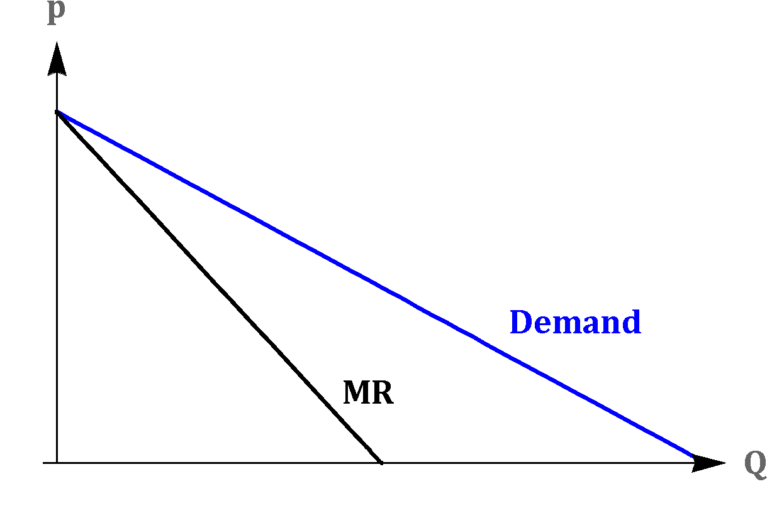




Profit Maximization
Example:

Slide 22
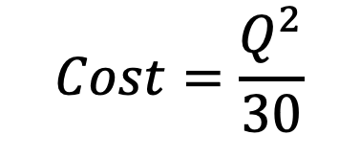


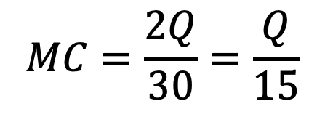


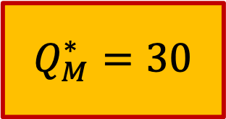
Profit Maximization
Example:

Slide 23

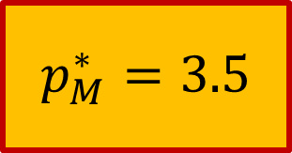

Profit Maximization
Example:

Slide 24


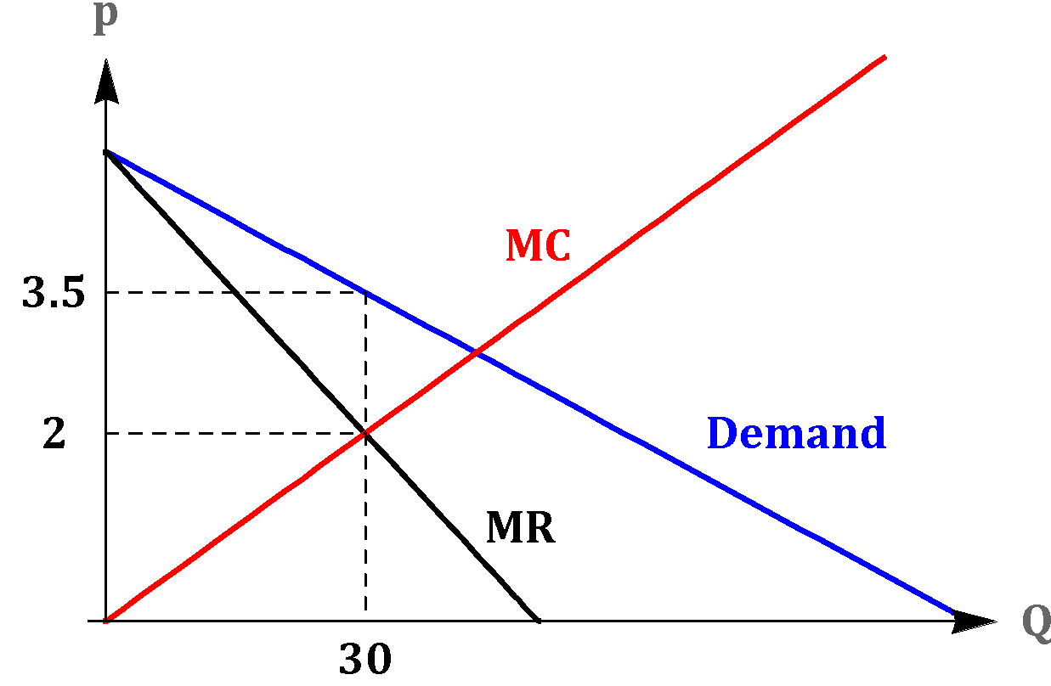
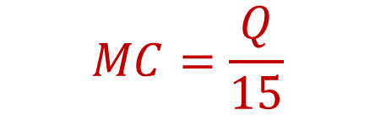
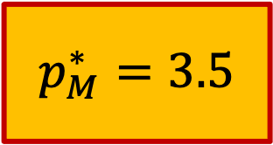
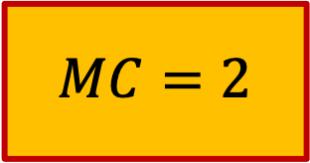
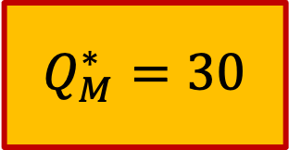
Profit Maximization
Example:

Slide 25


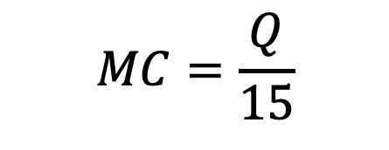
Profit Maximization
Example:

Slide 26
Profit Maximization
Example:

Slide 27
Profit Maximization
Example:
If the price is higher than the marginal cost, why doesn’t the firm produce one extra unit?

Slide 28



Profit Maximization
Example:
Revenue loss from lower price

Slide 29




Profit Maximization
Example:
Loss from lower price
Marginal Cost
Sale of new unit
Net Loss

Slide 30

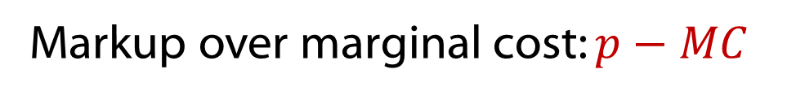
Profit Maximization
Perfect Competition
Monopolist
P=MC

Slide 31
Note
Under PC and Monopoly, MC=MR

Slide 32

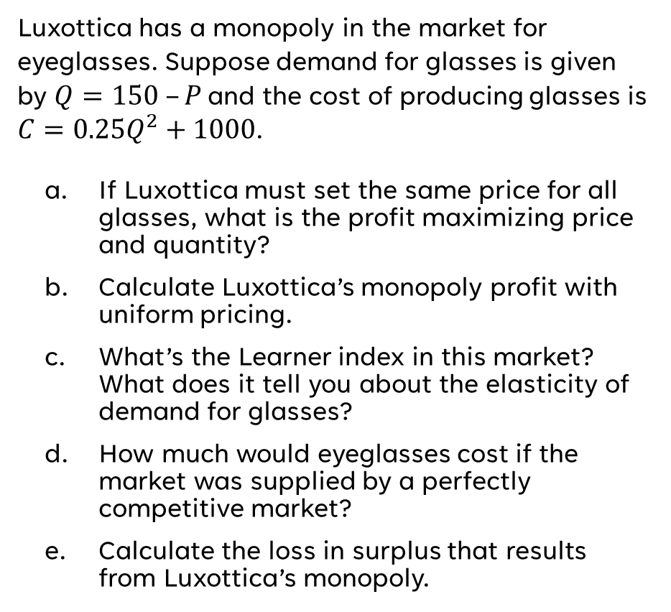
Monopoly
(Group Work)

Slide 33
So, how do you get a monopoly?

Slide 34
How Are Monopolies Created?
A monopoly is a single firm that:
  Sells a product without close substitutes
  It can prevent entry by new firms.
Monopoly power:
  Ability to set the price of a good or service
Barriers to entry:
  Restrictions that make it difficult for new firms to enter a market (crony capitalism)
Notes:
Lecture tip:
You could point out the difference between a pure monopoly and an effective monopoly, and what it means to have no “close substitutes.”
Microsoft’s monopoly over operating systems is a good example, since it’s power eroded over time due to new substitutes.
Monopoly power is sometimes referred to as market power.
Also, some economists would argue that monopoly power would also include the ability of firms to earn economic profit in the long run.
We will discuss two types of entry barriers:
Natural
Government created

Slide 35
Limiting Present and future Competition
Firm Level Barriers
Buying up competitors (horizontal integration)
Buying up inputs (vertical integration)
Regulatory Capture
Government Barriers
Patents
Licensing
Regulatory Capture
Industry Barriers
Natural Monopolies (network effects)

Slide 36
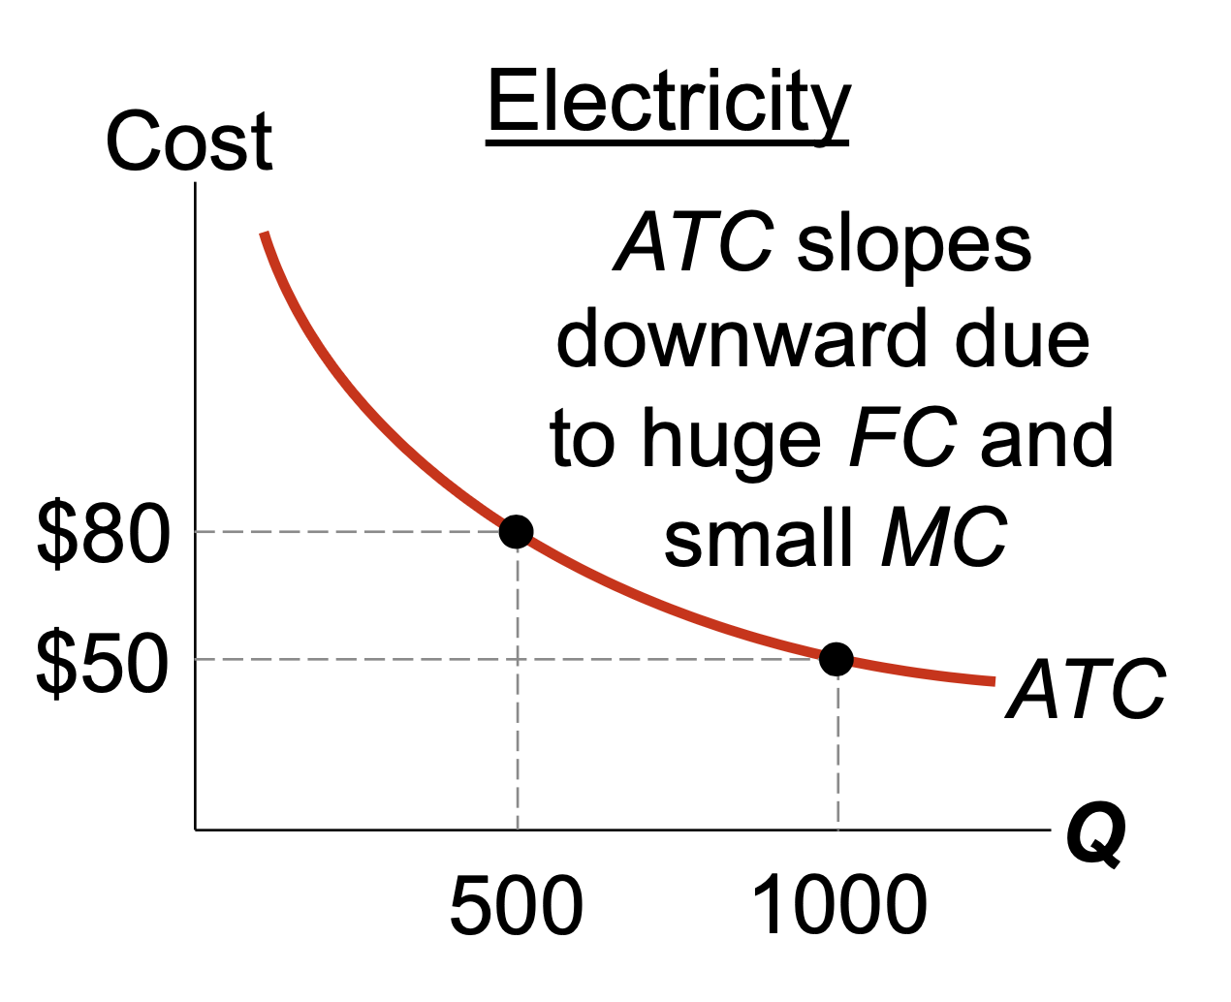
Special case
  Natural monopoly: a single firm can produce the entire market Q at lower cost than could several firms.
ATC is lower if
one firm services
all 1000 homes
than if two firms
each service
500 homes.
Notes:
‹#›
The horizontal axis of the graph measures number of homes provided electricity. The vertical axis measures the average total cost of providing electricity per home.

Slide 37
https://youtu.be/596eET8YW4I

Slide 38
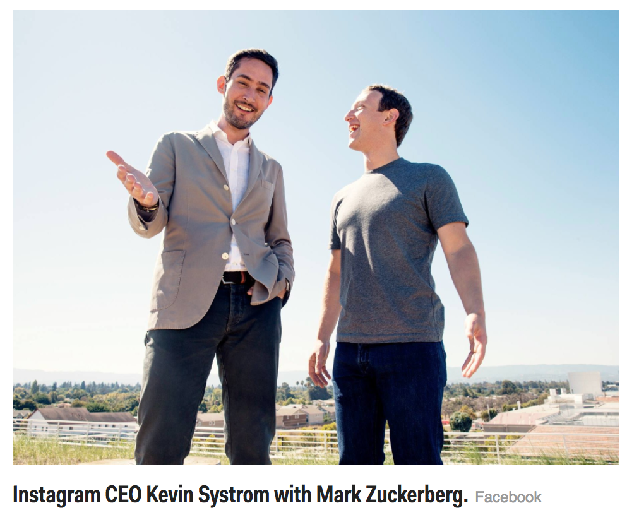
Case study: Facebook (monopoly maintenance)
2009 | Buys Friend Feed
2010 | Buys Divvy Shot (photo sharing)
2012 | Buys Instagram (1 Billion)
2013 | Buy Onavo (app tracking company)
Jan, 2014 | Snapchat spurns Facebook attempt to buy (3 Billion)
Feb, 2014 | Buys WhatsApp (16 Billion)
Jan, 2016 | Launches Facebook Live, a copy/competitor to Twitter’s Periscope
Aug, 2016 | Launches Instagram Stories (admit they copied Snapchat)
2017 | Buys tbh, an anonymous social media app
2023 | Copies Twitter (Threads)

Slide 39
Microeconomics for Business
Chapter 6 – Monopoly
Deadweight Loss and Price Regulation

Slide 40
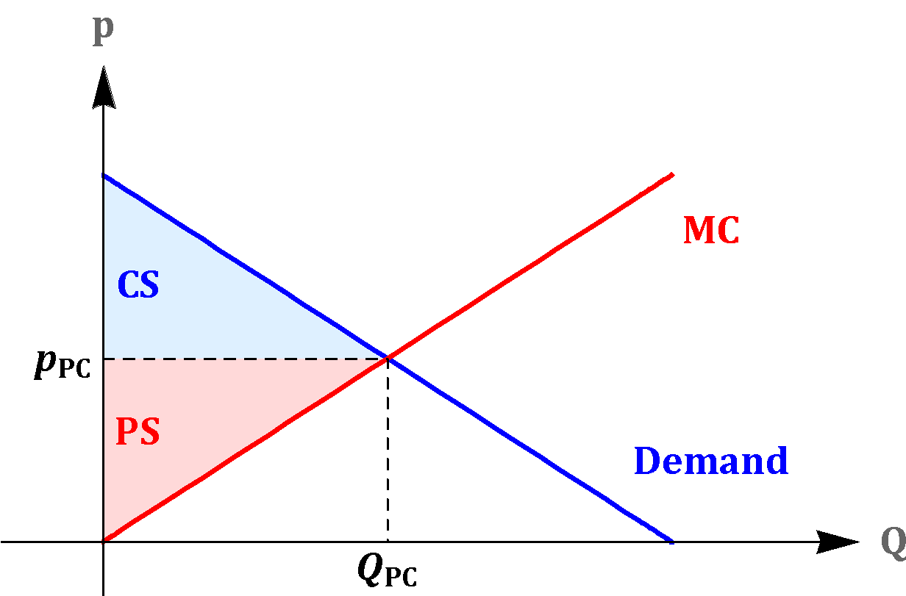
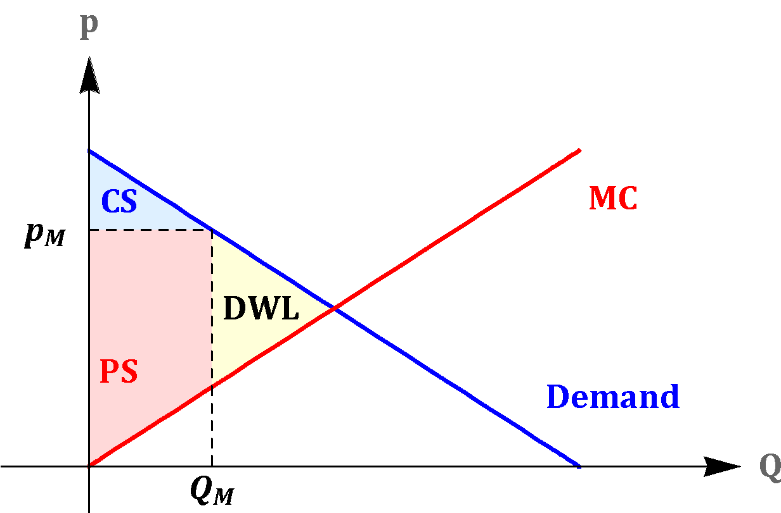


Deadweight Loss and Price Regulation
monopoly equilibrium

Slide 41
Monopoly
(Group Work)

Slide 42
Monopoly versus Competition
Q_{Monopoly}< Q_{Competition}
P_{Monopoly}> P_{Competition}
Deadweight Loss_{Monopoly}> 0
Notes:
Lecture notes:
A monopolist produces less output and charges a higher price than competitive markets do.

Slide 43
PC v. Monopoly
Contrasting Competition and Monopoly
 | Perfect Competition | Monopoly
Profits | “Normal” | High
Price | P=MC | P>MC

Slide 44
The Problems with Monopolies
Produce an inefficient level of output and charge an inefficient price
Less choice for consumers
Rent-seeking behavior
Notes:
Lecture notes:
The word “monopoly” often has a negative connotation. With a bad economy, we often hear people complaining about “greedy companies,” “Wall Street,” “banks,” and so on.
However, these entities are often not monopolies.
Monopolies are often economically inefficient. This comes from the fact that P > MC and that output is restricted compared to competitive markets.

Slide 45
Examples
Few choices
  Cable companies and bundling
  Forces you to buy more to get what you want
Rent seeking
  Occurs when resources are used to secure monopoly rights through the political process
  Resources used to monopolize rather than become a more competitive firm (i.e. innovation)
Notes:
Lecture notes:
Choices:
Since a monopoly sells goods with no substitutes, consumers pay higher prices than if there were other choices available.
With bundling you have to buy products (channels) you don’t want to get the products you do.
Rent seeking:
Time, effort, and resources are used in ways that attempt to gain monopoly or keep your existing monopoly.
Rather than spending money on making a better product or improving production, you spend money defending your monopoly.
This is an economically inefficient use of resources in this market.
You may want to discuss the “social cost” of a monopoly.
DWL + value of resources used to seek monopoly position
Possible benefits of monopoly: It may be worthwhile expanding upon this, since the text does not go into too much detail, so spend some time discussing some of the issues.
Analysis so far has assumed that marginal costs under perfect competition and monopoly are the same.
A monopolist may have lower MC and/or can take advantage of economies of scale. It is possible that price ends up being lower and output higher than under perfect competition.
Schumpeter and “creative destruction”
Monopoly power tends to be short-lived since there is another firm that will try to take over the market.
There is always a firm out there that can “build a better mousetrap.”
You could also discuss rent extraction as it relates to rent seeking.

Slide 46
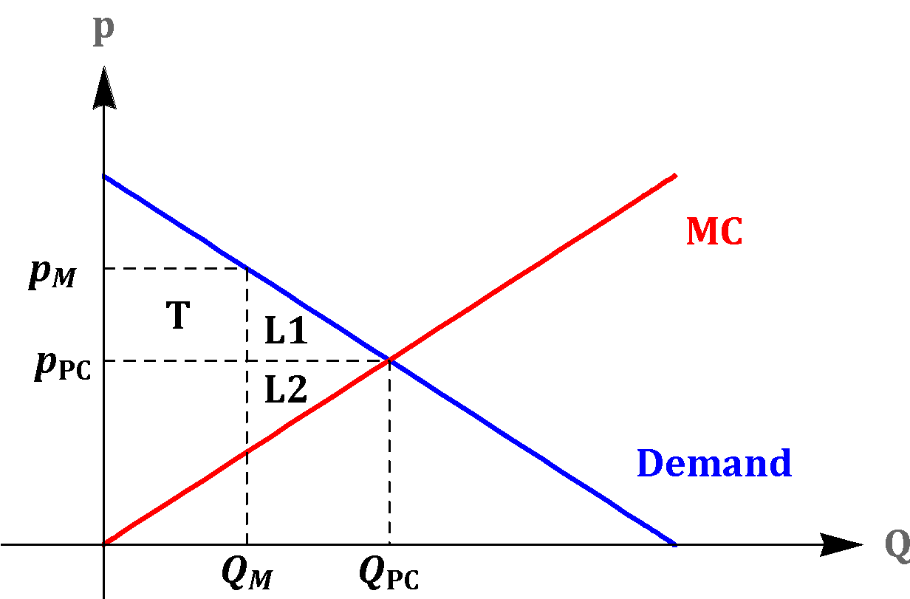
Deadweight Loss and Price Regulation
Change in CS = -T – L1 (T is a transfer to the monopoly and L1 is a DWL). Change in PS = T – L2 > 0 (T is the transfer from consumers and L2 is a DWL)
Monopoly
Competition
Perfect Competition
Monopolist
Change

Slide 47
Deadweight Loss and Price Regulation
Change in CS = -T – L1 (T is a transfer to the monopoly and L1 is a DWL). Change in PS = T – L2 > 0 (T is the transfer from consumers and L2 is a DWL)
Monopoly
Competition
Perfect Competition
Monopolist
Change

Slide 48
Deadweight Loss and Price Regulation
Markets with a monopolist are inefficient; thus, certain government policies can increase total surplus in such a market

Slide 49
Deadweight Loss and Price Regulation
Why are other firms not able to enter the market and compete?
Typically, the answer is that the monopoly has erected barriers to entry, or it has employed other strategies to limit competition.
What are the remedies?

Slide 50
Deadweight Loss and Price Regulation
There are two general remedies
The first would be to use the anti-trust laws to get the monopolist to fairly compete or to use these laws to break up the monopoly or prevent it from acquiring potential competitors.
The second would be to leave the monopoly in place, but regulate its price.

Slide 51
Breaking up Monopolies
Poor track record
  Government breaks up Standard Oil as its monopoly was waning (only people that benefitted were Standard Oil stockholders)
  Went after Microsoft as Microsoft’s dominance was ebbing
  Currently going after Google as Google’s dominance is decreasing, also Apple is a larger “monopoly” than google
  Biden FTC chair was aggressive, but courts threw out almost every case
Overall, tends to take action too late or politically motivated.

Slide 52
Government as source of Monopoly
government often the source of the monopoly.
This is called regulatory capture or crony capitalism
Incumbent firms getting regulations that limit future competition
Regulation costs an average of $9,093 per employee for a typical small firm, compared to $5,246 for a large firm.
Smaller firms invest relatively less in more highly regulated areas.
Examples
Universities with accreditation powers
Hospitals with approval powers for new hospitals
Banks (few new banks since Dodd-Frank passed in 2010 even as profits soar in the sector)
Sports – Why sports teams can be dysfunctional

Slide 53
Regulatory Capture https://youtu.be/OTFJbTDw150
“Politics is politics and investment is investment and that’s that. When a politician claims to be “investing,” he is engaged in politics. And when businesses partner up with politicians? That’s not politics—that’s an investment.”
― Kevin Williamson

Slide 54
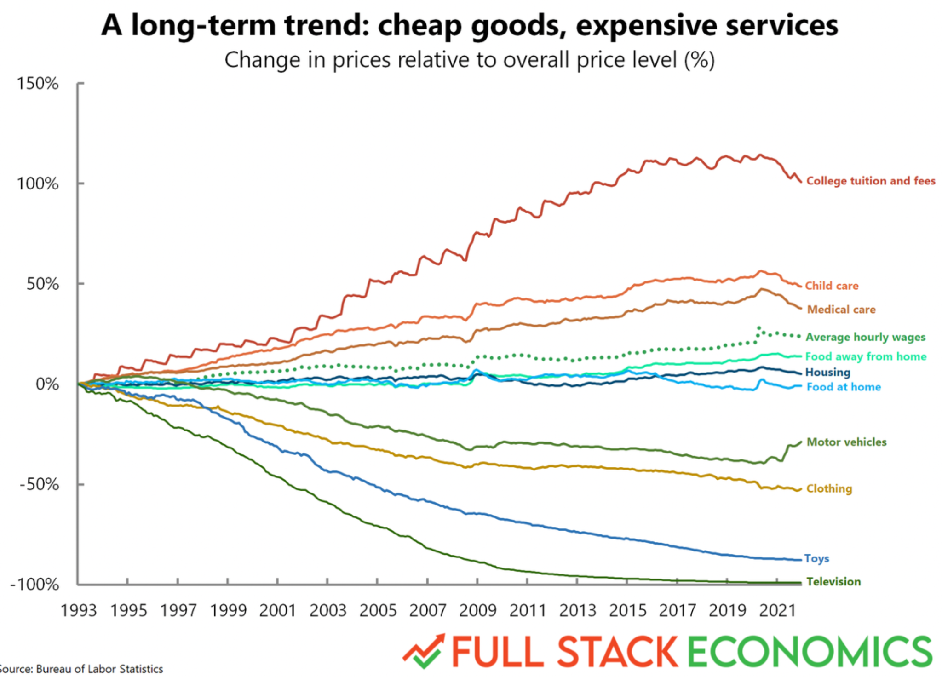

Slide 55

Deadweight Loss and Price Regulation
Suppose that the government does not want to break up the monopoly and wants to regulate its price.
Examples: granted patents, local public utilities

Slide 56

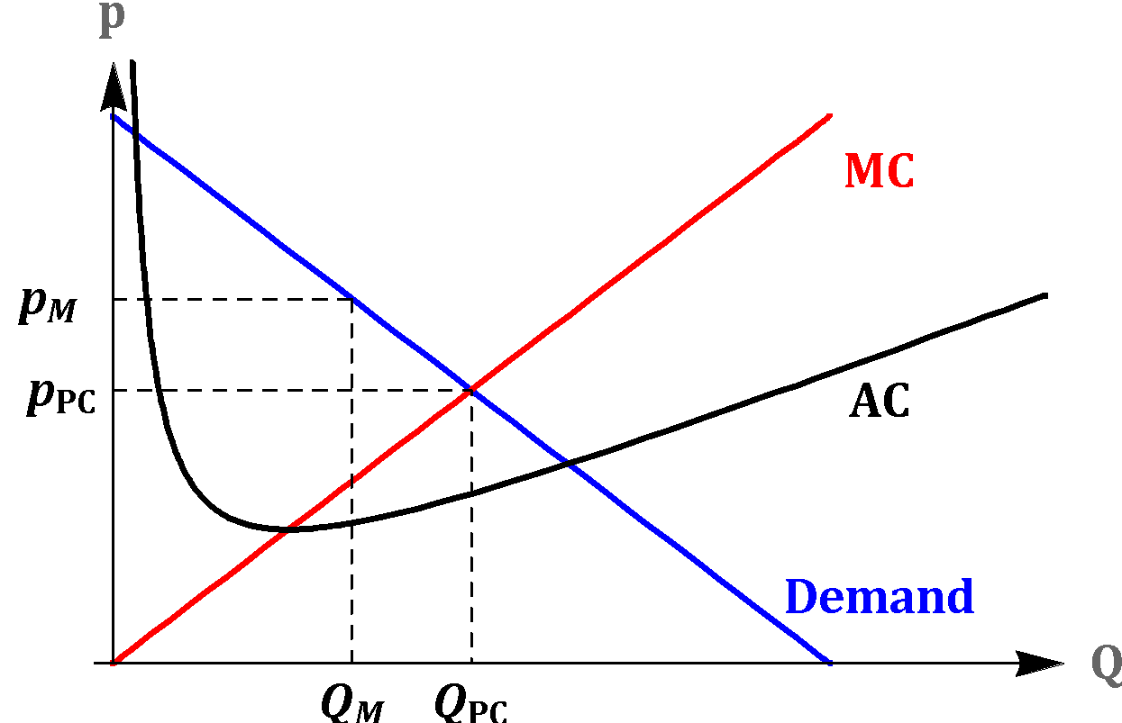
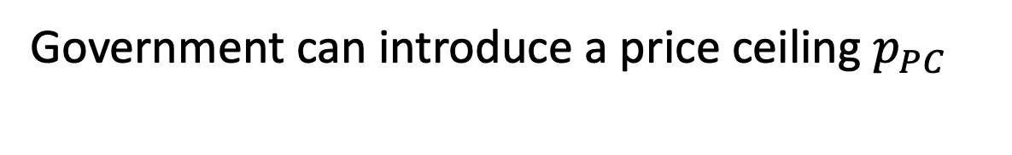
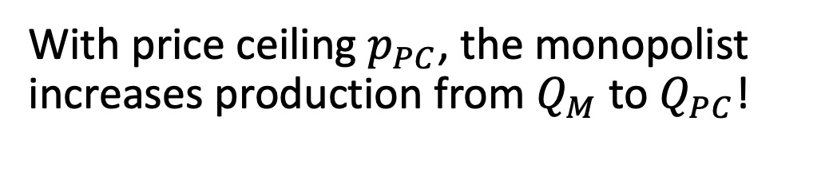
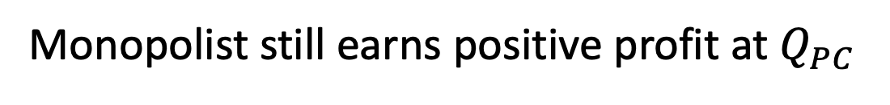
Deadweight Loss and Price Regulation

Slide 57
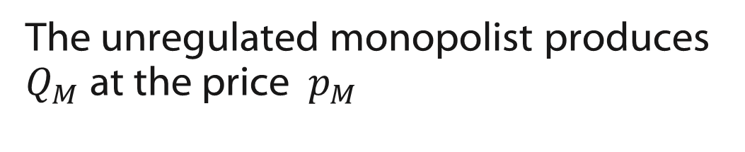

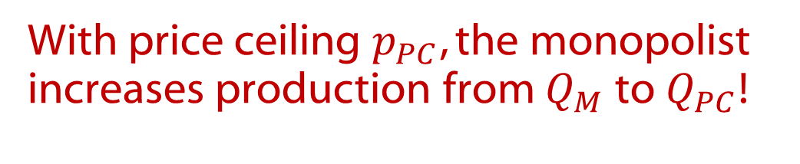
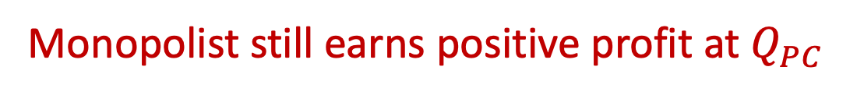
Deadweight Loss and Price Regulation

Slide 58
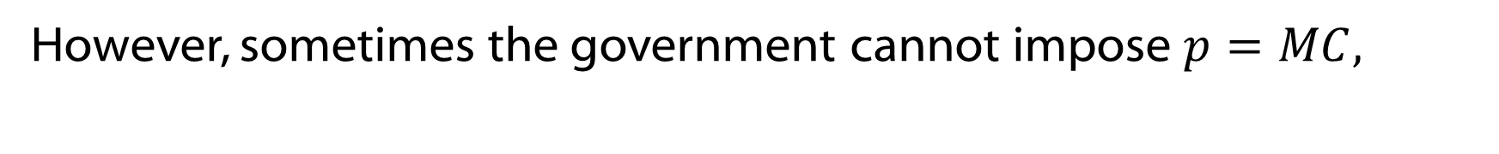
Deadweight Loss and Price Regulation
because this would result in a negative profit for the monopolist.
This happens when the average cost (AC) is declining in the relevant region of the demand. When this is true we have a natural monopoly.

Slide 59
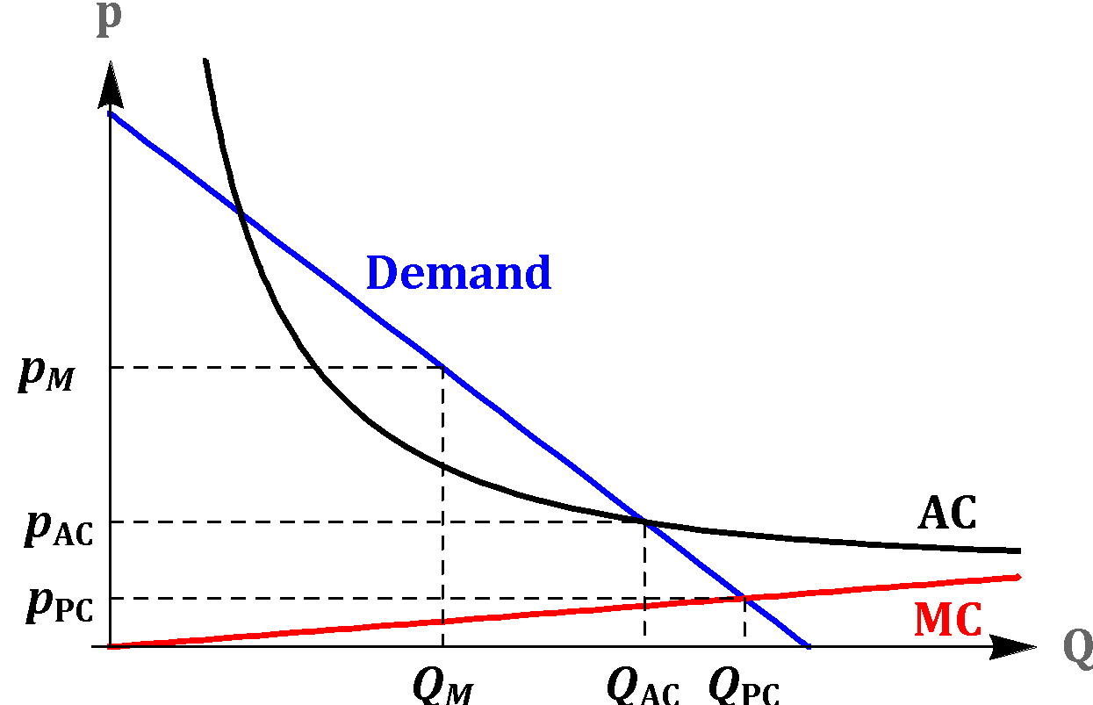
Deadweight Loss and Price Regulation
The diagram shows average cost declining in the relevant region of the demand (natural monopoly). This along with marginal cost pricing leads to a regulatory dilemma

Slide 60
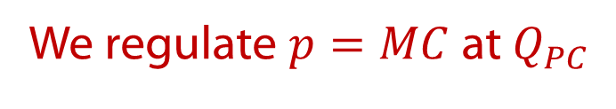
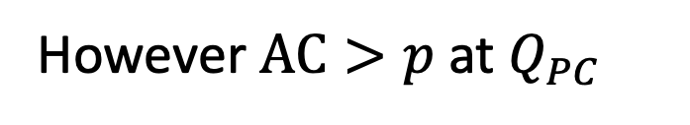

Deadweight Loss and Price Regulation
Negative Profit

Slide 61
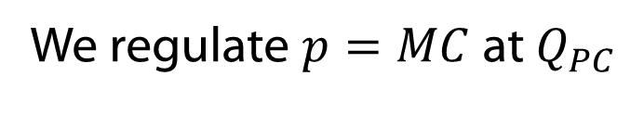


Deadweight Loss and Price Regulation
Negative Profit

Slide 62
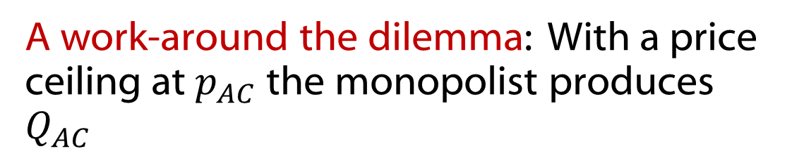
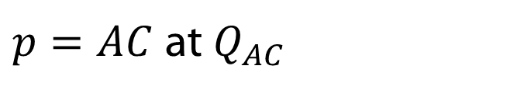

Deadweight Loss and Price Regulation
Zero Profit

Slide 63
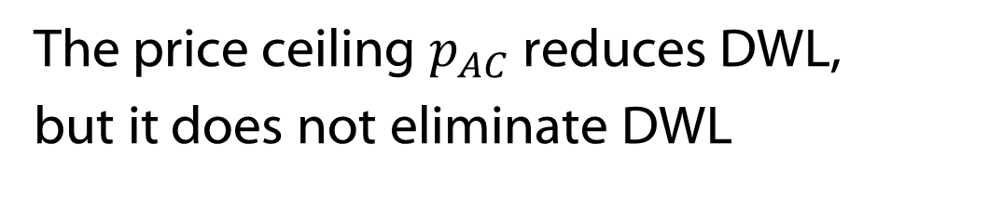
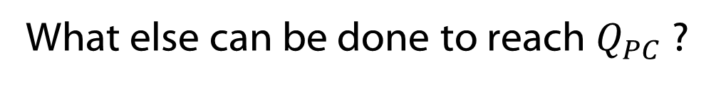
Deadweight Loss and Price Regulation
Subsidies to the monopoly with marginal cost pricing
Government becomes the monopolist

Slide 64
Caveat about Government Oversight
Government intervention
  Can eliminate the profit motive and the necessity to innovate and improve efficiency
  Government employees are rarely fired, regardless of performance
  Firms under MC pricing have no incentive to lower costs
Notes:
Lecture notes:
It all comes down to incentives.
The government can always “bail itself out,” so it has no incentive to be efficient, keep costs down, or fire bad employees.
A private firm has to take care of its own expenses and has the incentive to find and eliminate inefficiencies.

Slide 65
Conclusion
Monopolies control supply but not demand.
Competitive markets generally maximize social welfare. Monopolies lead to a welfare loss: dead weight loss.
Government seeks to limit monopoly outcomes and promote competitive markets.
Perfectly competitive markets and monopolies are market structures at opposite extremes.
Notes:
Lecture notes:
We can think of perfect competition (PC) and pure monopoly in the theoretical sense because they are very rare (by strict definition and assumptions) in real life. Many firms have some competitive characteristics and some monopolistic characteristics. This will be studied in the upcoming chapters.
You can conclude this lecture by reiterating the following points:
On monopolies:
Single seller
Produces a product with few good substitutes
High barriers to entry
Emphasize the importance of barriers to entry as the main source of a monopoly’s market power.
May earn long-run profits
A monopoly maximizes profit by producing where MR = MC.
A monopoly is inefficient, and leads to a deadweight loss.
Government grants of monopoly power encourage rent seeking.
There are three potential solutions to the problem of monopoly.
Ask students whether they think there is a “fourth solution.”

